Slide 1
Introduction to Startups
Webinar
organised by
Loreto College, Kolkata
April 24, 2021
Dr. Kalpeshkumar L Gupta
Associate Professor of Law, Parul University & Founder of ProBono India, Legal Startups
www.legalstartups.info

Slide 2
What do you want to do after your study?
klgupta.in

Slide 3
Points for discussion
What do you mean by startup?
What is the need of the startup?
Why startup succeed?
Types of Entrepreneurship
Startup Ecosystem
Legal Aspects involved in Startup
My Story
klgupta.in

Slide 4
1. What do you mean by Startup?
klgupta.in

Slide 5
Startups
#A startup is a young company that is just beginning to develop.*
#Startups are usually small and initially financed and operated by a handful of founders or one individual. These companies offer a product or service that is not currently being offered elsewhere in the market, or that the founders believe is being offered in an inferior manner.*
#Startups are entrepreneurial ventures and new businesses focused on searching for a repeatable and scalable business model.**
#Startups are focused on rapid growth and the potential for substantial future revenue.**
*https://www.investopedia.com/ask/answers/12/what-is-a-startup.asp
klgupta.in
**https://digitalcommons.law.msu.edu/cgi/viewcontent.cgi?article=1540&context=facpubs

Slide 6
Startups
A startup is a company working to solve a problem where the solution is not obvious and success is not guaranteed.
- Neil Blumenthal, cofounder and co-CEO of Warby Parker
klgupta.in

Slide 7
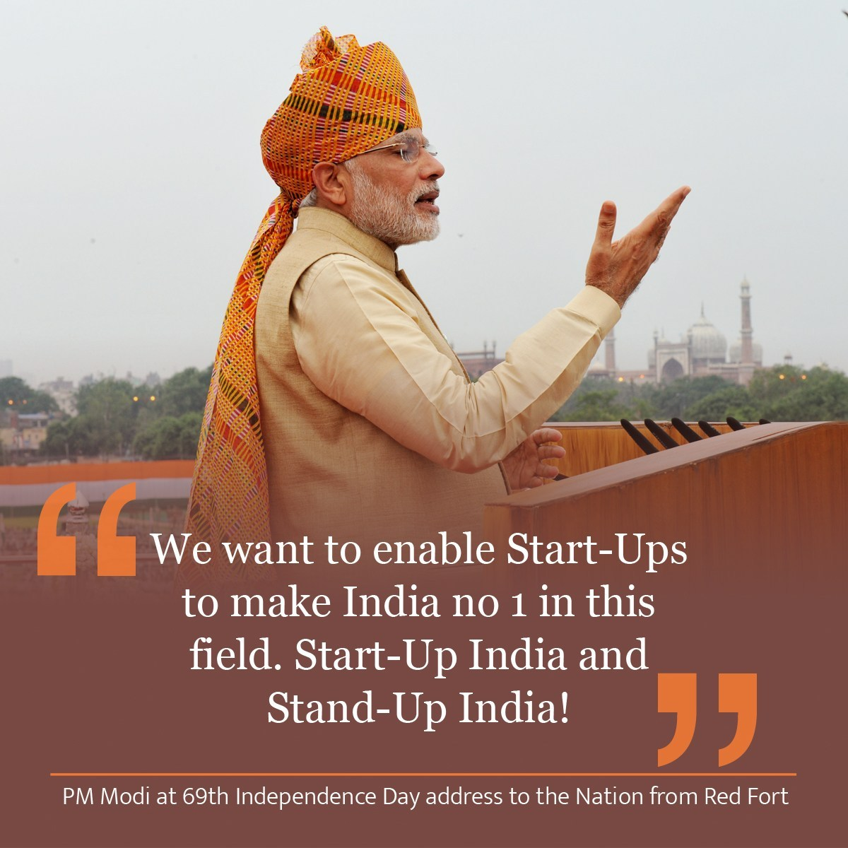
The campaign was first announced by Indian Prime Minister, Narendra Modi during his 15 August 2015 address from the Red Fort, in New Delhi.
The action plan of this initiative, is based on the following three pillars:
1. Simplification and Handholding.
2. Funding Support and Incentives.
3. Industry-Academia Partnership and Incubation.
Cont…
klgupta.in

Slide 8
MINISTRY OF COMMERCE AND INDUSTRY (Department of Industrial Policy and Promotion) NOTIFICATION New Delhi, the 11th April, 2018
An entity shall be considered as a Startup:
i. Upto a period of 10 years from the date of incorporation/registration,
if it is incorporated as a private limited company (as defined in the Companies Act, 2013) or registered as a partnership firm (registered under section 59 of the Partnership Act, 1932) or a limited liability partnership (under the Limited Liability Partnership Act, 2008) in India.
ii. Turnover of the entity for any of the financial years since incorporation/ registration has not exceeded Rs. 100 crore
iii. Entity is working towards innovation, development or improvement of products or processes or services, or if it is a scalable business model with a high potential of employment generation or wealth creation.
Cont…
https://dipp.gov.in/sites/default/files/Startup_Notification11April2018_0.pdf
klgupta.in

Slide 9
Cont…
MINISTRY OF COMMERCE AND INDUSTRY (Department of Industrial Policy and Promotion) NOTIFICATION New Delhi, the 11th April, 2018
Provided that an entity formed by splitting up or reconstruction of an existing business shall not be considered a ‘Startup’.
Explanation
An entity shall cease to be a Startup on completion of 10 years from the date of its incorporation/ registration or if its turnover for any previous year exceeds Rupees 100 crore.
https://dipp.gov.in/sites/default/files/Startup_Notification11April2018_0.pdf
klgupta.in

Slide 10
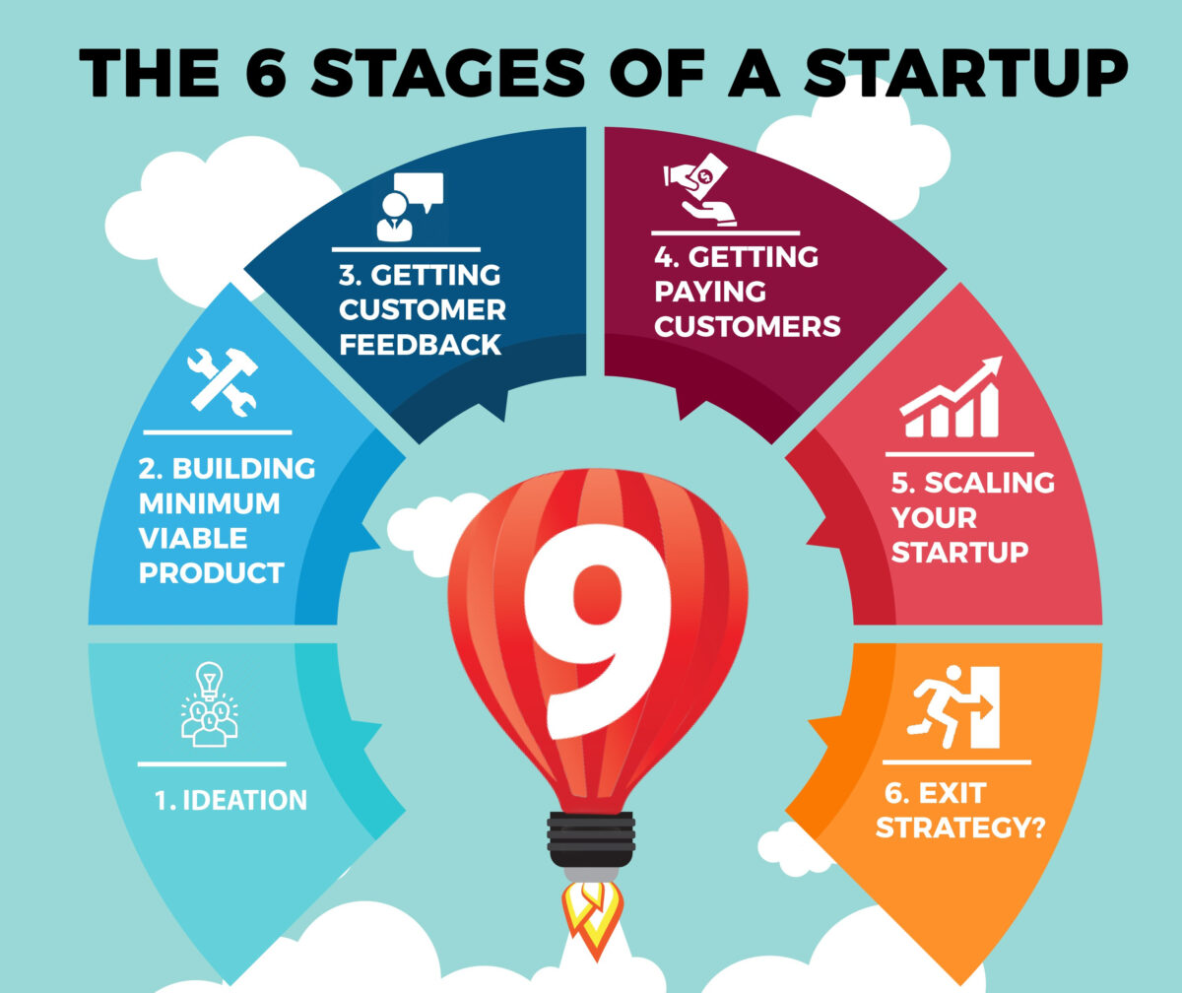
Stages of Startup
https://www.thecontentstartup.com/what-are-the-phases-of-a-startup/
klgupta.in

Slide 11
2. What is the need of Startup?
klgupta.in

Slide 12
Need of Startup
Problem solving
Innovative approach
Economic Development
Generation of Employment
klgupta.in

Slide 13
3. What Startup succeed?
klgupta.in

Slide 14
Why startup succeed?
Source :- https://www.youtube.com/watch?v=bNpx7gpSqbY
klgupta.in

Slide 15
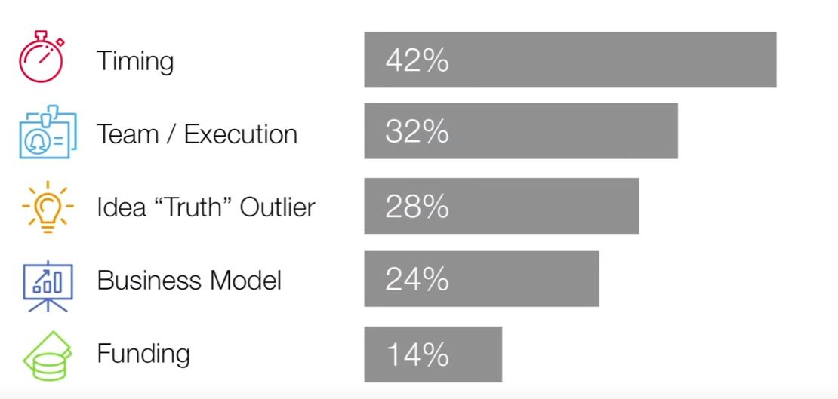
Why startup succeed?
Findings by Bill Gross – “Why Startup Succeed”
klgupta.in
https://www.ted.com/talks/bill_gross_the_single_biggest_reason_why_start_ups_succeed?language=en

Slide 16
4. Types of Entrepreneurship
klgupta.in

Slide 17
Types of Entrepreneurship
Entrepreneurship
Social Entrepreneurship
Various other terms
Social Entrepreneur
Womenpreneur
Techpreneur/Technopreneur
Edupreneur
Legalpreneur
Disasterpreneur
(Recent Pandemic, Mask & Sanitizer business)
klgupta.in

Slide 18
5. Startup Ecosytem
klgupta.in

Slide 19
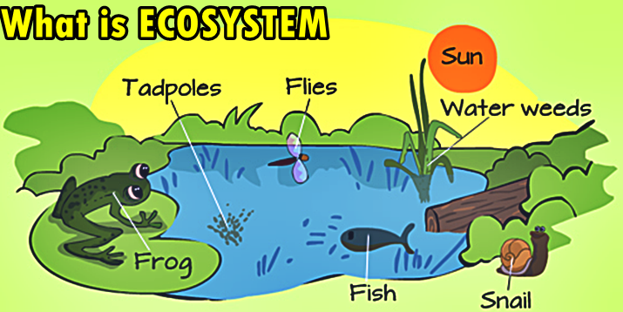
What is Ecosystem ?.....scientific term
An ecosystem is a community of living organisms in conjunction with the nonliving components of their environment, interacting as a system.
klgupta.in

Slide 20
What is Startup Ecosystem?
A startup ecosystem is formed by people, startups in their various stages and various types of organizations in a location (physical and/or virtual), interacting as a system to create new startup companies.
These organizations can be further divided into categories:
universities, funding organizations, support organizations (like incubators, accelerators, co-working spaces etc.), research organizations, service provider organizations (like legal, financial services etc.) and
large corporations. Different organizations typically focus on specific parts of the ecosystem function and/or startups at their specific development stage(s).
https://www.startupcommons.org/what-is-startup-ecosystem.html
klgupta.in

Slide 21
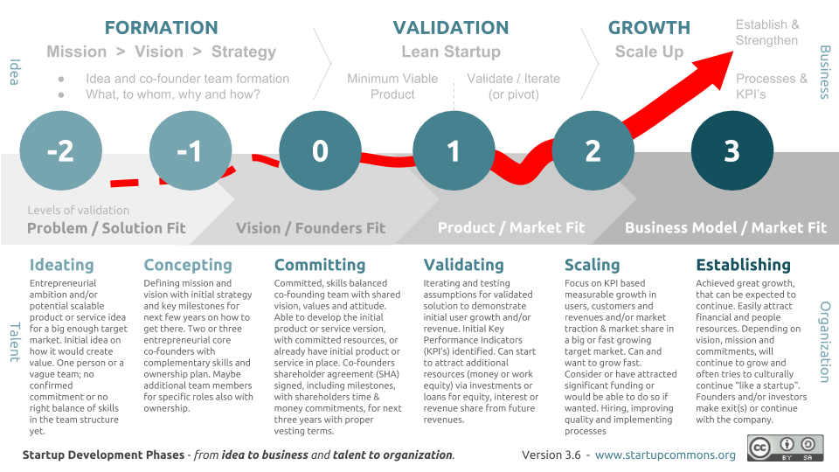
Stages of Startup & Startup Ecosystem
Start Ecosystem means all support system required during the period of Startup Journey.
klgupta.in

Slide 22
What is Startup Ecosystem?
https://www.startupcommons.org/what-is-startup-ecosystem.html
klgupta.in

Slide 23
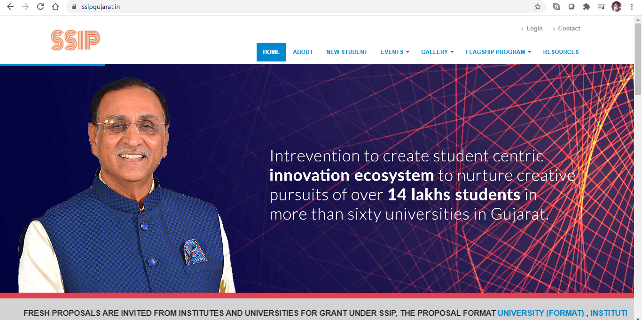
https://www.ssipgujarat.in/
klgupta.in

Slide 24
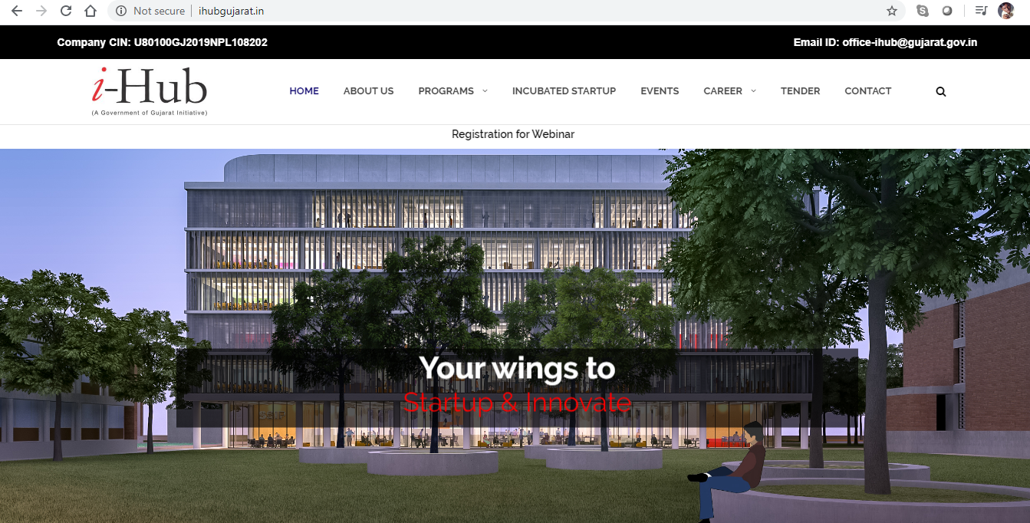
Example :- i-Hub set up by Govt. of Gujarat
Gujarat Student Startup and Innovation Hub, registered under Section 8 of the companies Act 2013, is envisioned to be a nexus for all Startup stakeholders to develop an end-to-end innovation and entrepreneurial ecosystem in the State of Gujarat by creating pathways from “Mind-to-Market”. i-hub is a vibrant incubation setup established under SSIP by the Education Department, Government of Gujarat.
klgupta.in
http://ihubgujarat.in/

Slide 25
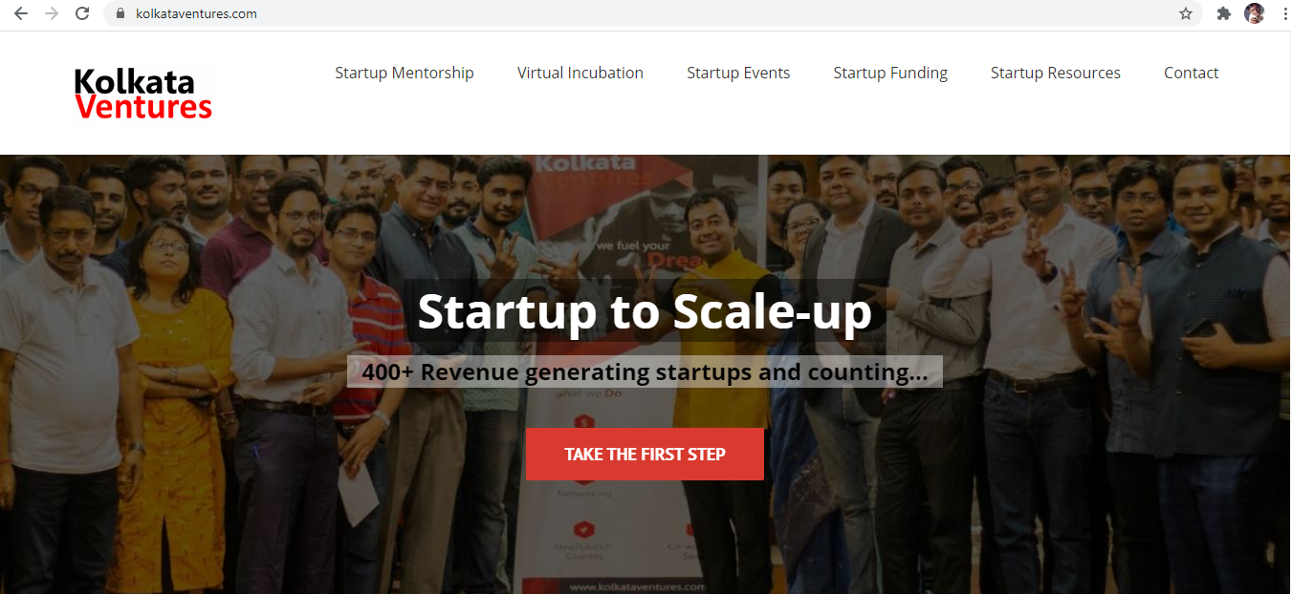
https://kolkataventures.com/
klgupta.in

Slide 26
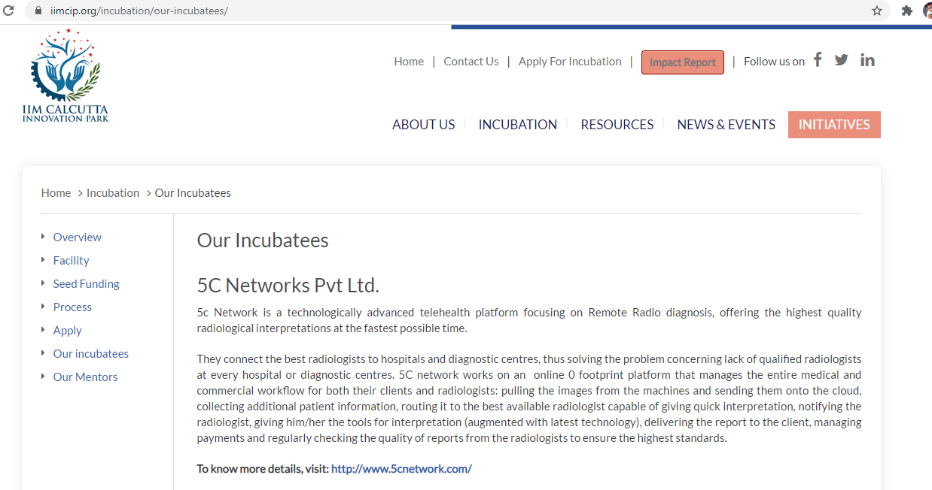
https://iimcip.org/incubation/our-incubatees/
klgupta.in

Slide 27
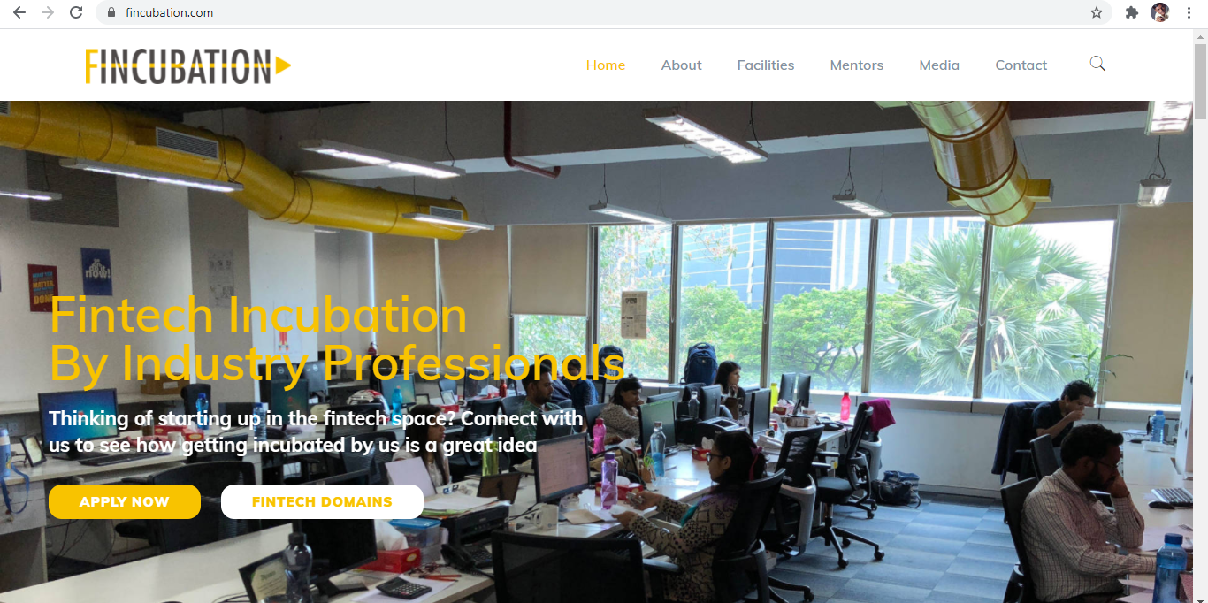
https://fincubation.com/
klgupta.in

Slide 28
Gujarat best state in providing strong ecosystem for startups: Dept of Industrial Policy & Promotion ranking
2018 Startup State Ranking are as follows:
Best performer: Gujarat
Top performers: Karnataka, Kerala, Odisha, and Rajasthan
Leader: Andhra Pradesh, Bihar, Chhattisgarh, Madhya Pradesh, and Telangana
Aspiring leaders: Haryana, Himachal Pradesh, Jharkhand, Uttar Pradesh, and West Bengal
Emerging states: Assam, Delhi, Goa, Jammu & Kashmir, Maharashtra, Punjab, Tamil Nadu, and Uttarakhand
Beginners: Chandigarh, Manipur, Mizoram, Nagaland, Puducherry, Sikkim, and Tripura
https://economictimes.indiatimes.com/small-biz/startups/newsbuzz/gujarat-best-state-in-providing-strong-ecosystem-for-startups-dipp-ranking/articleshow/67176184.cms
klgupta.in

Slide 29
Gujarat best state in providing strong ecosystem for startups: Dept of Industrial Policy & Promotion ranking
2019 Startup State Ranking are as follows:
Best performer: Gujarat
Top performers: Karnataka, Kerala
Leader: Maharashtra, Bihar, Odisha, Rajasthan
Aspiring leaders: Punjab, Telangana, Uttarakhand, Jharkhand, Haryana
Emerging states: Chhatisrgarh, Uttar Pradesh, Tamil Nadu, Sikkim, Nagaland, Mizoram, Madhya Pradesh, Assam
S
klgupta.in

Slide 30
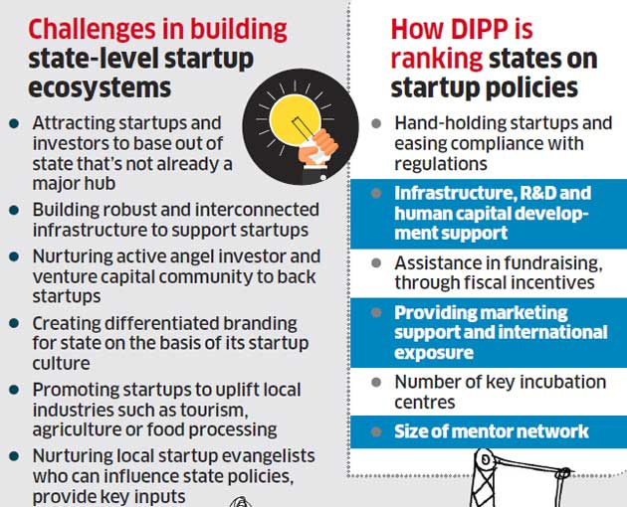
Gujarat best state in providing strong ecosystem for startups: Dept of Industrial Policy & Promotion ranking
klgupta.in

Slide 31
90% Of Indian Startups Will Fail Because Of Lack Of Innovation, Study Says
Of late, India might have become the third-largest startup ecosystem, but it lacks successful innovation.
Notwithstanding the fact that market valuation of Indian startups has grown significantly over the past four years, a recent study, “Entrepreneurial India,” by the IBM Institute for Business Value and Oxford Economics found that 90% of Indian startups fail within the first five years. And the most common reason for failure is lack of innovation.
77% of venture capitalists surveyed believe that Indian startups lack new technologies or unique business models
https://www.forbes.com/sites/suparnadutt/2017/05/18/startups-in-india-fail-due-lack-of-innovation-according-to-a-new-ibm-study/#201e3c89657b
klgupta.in

Slide 32
90% Of Indian Startups Will Fail Because Of Lack Of Innovation, Study Says
It's well known that most Indian startups are prone to emulate successful global ideas, by and large fine-tuning an existing model to serve local needs.
https://www.forbes.com/sites/suparnadutt/2017/05/18/startups-in-india-fail-due-lack-of-innovation-according-to-a-new-ibm-study/#201e3c89657b
klgupta.in

Slide 33
6. Legal Aspects Involved in Startup
klgupta.in

Slide 34
Legal Aspects Involved in the Startups
Primary Compliances e.g. local bodies permission
Forms of Business
Intellectual Property Rights
Sectoral Regulation Compliances e.g. Councils, Authorities
klgupta.in

Slide 35
7. My Story
klgupta.in

Slide 36
My Story
2016
2017
klgupta.in
probono-india.in
2018
2019
legalstartups.info
courtmanagement.in
klgupta.in

Slide 37
Dr. Kalpeshkumar L Gupta
www.klgupta.in
Mob. 99248 97691

